Slide 1



Hack-7-Days
X
Tezos India x Hansraj College
Hansraj College, University of Delhi
TEAM NAME : HACK IT IP
1

Slide 2
HACK IT IP
TEAM NAME: HACK IT IP
PROJECT TITLE: TOSS GAME
PRAKRITI SHREE(Team Lead)
BHAVIKA SHRIVASTAVA
MIHIKA KISHOR
UPASANA TRIVEDI
2

Slide 3

PROBLEM STATEMENT
Explain the problem statement
The Toss game , a smartpy encoded game made for risk seeking investors , those who consider the return factor more than the risk factor to try their luck where the stakes are high and rewards are even higher.
What is the problem you are trying to solve? Validate the problem with real life examples.
All a user has to do to unlock hidden gems of profitability through pocket size investments all a user has to do is “FLIP A COIN!”
3

Slide 4
Your Solution / Product / Services
01
Explain your idea here.
A toss game wherein we will have participants from the Tezos blockchain(their tezos addresses will be used for reference) and they will bet a certain amount of mutez on tossing game ; the winner will be awarded 1 tez and those not winning will lose their bet amount.
4

Slide 5
02 :Give a brief about your approach
The code of the game is written as a smart contract in python language using the smartpy library.
This smart contract is deployed as Michelson deploy contract.
The front-end of the code is written in HTML and CSS.
The front end and the smart contract of the game is linked via taquito (java script).

Slide 6
03: Explain the working
First the choice of the side of coin (weather head or tail) is asked from the user.
Then a bet amount is asked with a minimum criteria of 20 mutez.
Then a random number is asked ,which is divided by 2 leaving the remainder 0 or 1 which will be stored in another variable where 0 denotes Heads and 1 denotes Tails.
If the side of coin denoted by that variable matches with the choice entered by user then the user will be awarded a prize amount of 1 tezos.

Slide 7
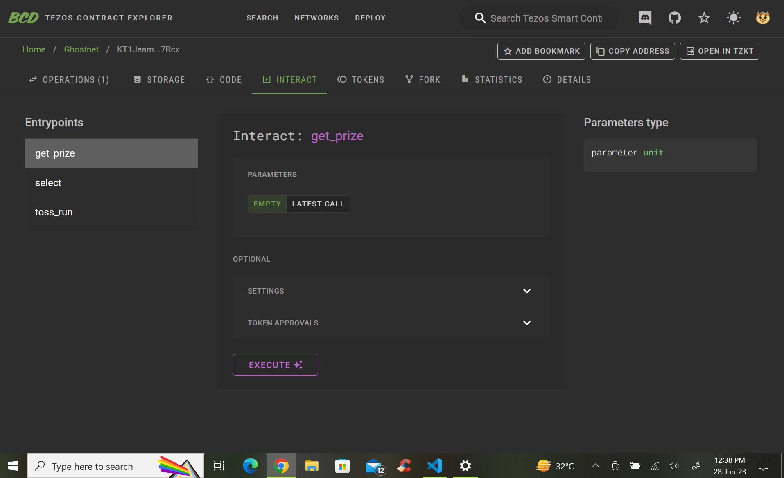

Product Demo
Choose Side: User selects heads .
Bet Amount: User enters 20 mutez
Coin Flip: 62 (Random number is divided by 2.
Result Announcement: User is notified that they win 1 tez.
Exit: End Screen
5

Slide 8
TECHNOLOGIES USED
Smartpy
HTML
CSS
Taquito (javascript)
6

Slide 9
Github link to our project :
https://github.com/prakritishree/HackItIp
Smart Contract link to our project
https://legacy.smartpy.io/ide?code=eJytVUuL2zAQvudXDA4Fm6Ymm2NaQx_00EtZ2L2VYibyJBGxZSMpCdll_3tH8kveV9lSHxJ53t_om7GsmlpbMBVq21wADZhmNhMlGgO3tTE7rCg2TfqtVlajsMl6BvwUtIU8l0raPI8NldsFnKVSpDu9e5w4dSbxIHJPa5e1f4uJakM2x6o@KptxygqbuMzuHxZgD3RxktsvRaHJGJacsDySl_1Em0zDGFlQLva1FPSGODdWS7VLhkjtyf98Zj0x_kve1FLZoQOMkIT1@Bn34DkXexKH4bWtxEAGXTH30Z6wMNEarhYQWZSlPz@MudnwRFpuL3HnnAruP0plfLK0QItpAPMXOxhSBenfyQIqhoY7yqIfiuHJwjekKyPGsgSpoKzPpAUaStLoubxjmvFSgizwydkqtPFqGWb8rixpd4_QukBVawK7RwWrJVRHS3ec7tWmWmZdro@qpZVGVdRVro7VZkKuOVyT3ta6AsHe3mnQKTp3DtnE_d0qBGoYl700FI_mC@gJxfGXa39L8BGu1v6O@ESlIdD0gRzMWRhNbsO02XI9ZaQ3@NvVQZZBT42JezA2g_Uku6vrnzN2BHxDxjlME87b36ExU3nY68l9jO1@nRE79m60vKN@0l4C2VbsQA1FT2HN4YalzEd3i2fUfKz9W@v5uIMuRPw4vK96gyUqQUHhWBS5JWNjxRuTZz2qeFy70fK0drqwdkEKtazbteC0eS@Kk6CDt6wBFMJN00hxLCpm_ejaGcSRVwQTfa3xoKWVz9n2usD86x5P8oDPWXeqwDiosv888Gox1nVm0LnJ5HDDt6Rjla_TNc3t4eRpV95n05keczEbGBWz4YlTul85UKzi2xWSTrzPo5djpyOvktQtnG5lddjv4ivebC2LWNY363_F69rJDHqKccLDV9SzPyhsR5Q-

Slide 10
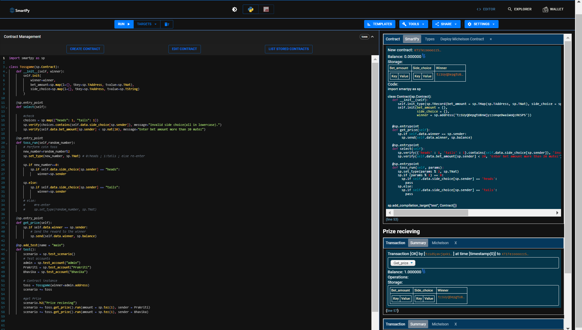

Slide 11
Link to the deployed contract :
KT1Jeam3QvVkfdMCYCg1tGC26rZELQqx7Rcx

Slide 12
